Slide 1
The Economics of Change: How Development Transforms Societies

Slide 2
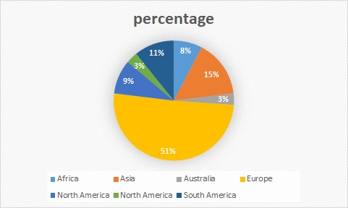
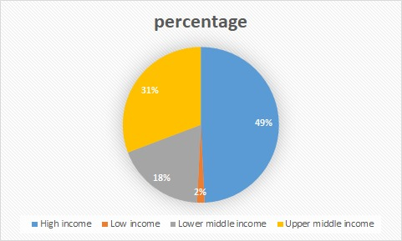
INTRODUCTION
This project explores the economic performance of 65 countries over two distinct years, leveraging data from the World Bank Open Dataset.
The study focuses on a diverse group of countries, which we classified into three categories:
rich (like USA, UK, Germany, etc), middle-income (Brazil, Poland, Greece, etc) and low-income countries (like Indonesia, Niger, Mongolia, etc).
Key Focus Areas:
Income transitions
Economic growth distribution
Poverty reduction and inequality changes

Slide 3
ANALYTICAL TOOLS:
Our analysis employs various tools to evaluate and compare the economic dynamics of these countries:
Mobility Matrices: We use these to examine transitions in income and economic standings in the concerned years. Mobility matrices provide insights into the movement of countries across different income categories or growth rates.
Growth Incidence Curves (GICs): These curves offer a detailed look at income growth rates across different percentiles of the population, helping us understand how economic growth was distributed within each country.
Dollar and Kraay Regression: To further analyze the relationship between economic growth and income distribution, we adopt the Dollar and Kraay regression framework. This involves regressing changes in GDP per capita against changes in income distribution to assess how growth translates into poverty reduction and inequality changes.
By employing these methods, our study aims to provide a comprehensive assessment of the economic performance of the selected countries, shedding light on growth patterns, income distribution, and mobility during the period under review.

Slide 4
INSIGHTS FROM MOBILITY MATRIX
Mobility matrices are essential tools in economics and social sciences for analyzing dynamic changes across states or categories over time.
They track the movement of entities—such as individuals, households, or countries—across predefined states, such as income levels or economic strata.
They analyze stability, upward/downward mobility, and structural transformations, and offer a clear view of economic transitions and development patterns
Income mobility matrices reveal economic transitions among countries by categorizing nations into income levels and tracking movements over decades.
Study of Income Transitions (1980–2020):
-Significant global economic shifts were noted between 1980–2000 and 2000–2020.
-Income group shares provide insights into relative economic positions.

Slide 5
INCOME TRANSITIONS (1980–2000)
Stability at Low-Income Levels (0.25 Share):
Countries like Bangladesh, Costa Rica, and Ecuador remained in the 0.25 income share group. Experienced growth but failed to move out of the lower income bracket.
Upward Mobility (0.25 to 0.5 Share):
Egypt, Hong Kong, and Malaysia transitioned to a 0.5 share. Reflects effective policies, industrialization, and global trade integration.
Downward Mobility(From 0.5 to 0.25 share, and 1 to 0.5):
The Philippines faced political instability and economic stagnation. From 1 to 0.5 Share: Indonesia, Denmark, and South Africa declined due to economic crises or structural issues.
Count of Country Name | 2000
1980 | 0.25 | 0.5 | 1 | 2 | infinity | Column Total
0.25 | 39% | 5% | 0% | 0% | 0% | 44%
0.5 | 8% | 8% | 5% | 0% | 0% | 22%
1 | 2% | 0% | 2% | 7% | 0% | 10%
2 | 0% | 0% | 2% | 7% | 0% | 8%
infinity | 0% | 0% | 0% | 3% | 12% | 15%
Row Total | 49% | 14% | 8% | 17% | 12% | 100%

Slide 6
INCOME TRANSITIONS (2000–2020)
Continued downward mobility:
Indonesia and Norway: Fell from 1-share to 0.5-share, reflecting stagnation and inequality challenges.
Hong Kong: Declined from 1-share to 0.5-share, indicating struggles in sustaining growth.
Upward mobility:
Indonesia: Rebounded to a 2-share level, showcasing recovery and robust growth.
Hong Kong: Rose from 2-share to greater-than-2 share, overcoming earlier hurdles through diversification.
Consistent Declines (1980–2020):
Canada, Switzerland, and South Africa faced persistent economic challenges, resulting in sustained declines.
Steady Growth:
China and India: Continued their upward trajectory, driven by large-scale reforms, industrialization, and integration into global markets.
Count of Country Name | 2020
2000 | 0.25 | 0.5 | 1 | 2 | infinity | Column Total
0.25 | 41% | 0% | 0% | 0% | 0% | 41%
0.5 | 3% | 19% | 3% | 0% | 0% | 25%
1 | 0% | 2% | 7% | 0% | 0% | 8%
2 | 0% | 2% | 0% | 7% | 3% | 12%
infinity | 0% | 0% | 0% | 2% | 12% | 14%
Row Total | 44% | 22% | 10% | 8% | 15% | 100%

Slide 7
INCOME TRANSITIONS (1980–2020)
Economic Convergence and Divergence:
Success stories like Egypt and Malaysia demonstrate upward mobility.
Reversals in countries like the Philippines and South Africa highlight uneven global economic dynamics.
Policy and Structural Factors:
Upward mobility is linked to effective policies, industrial diversification, and global trade integration (e.g., China, India).
Political instability and structural deficiencies hinder progress (e.g., Philippines).
Resilience and Recovery:
Examples like Indonesia show recovery potential after downturns, underscoring the dynamic nature of economic systems.
Count of Country Name | 2020
1980 | 0.25 | 0.5 | 1 | 2 | infinity | Column Total
0.25 | 37% | 3% | 0% | 0% | 0% | 41%
0.5 | 12% | 8% | 5% | 0% | 0% | 25%
1 | 0% | 2% | 0% | 7% | 0% | 8%
2 | 0% | 0% | 3% | 7% | 2% | 12%
infinity | 0% | 0% | 0% | 3% | 10% | 14%
Row Total | 49% | 14% | 8% | 17% | 12% | 100%

Slide 8
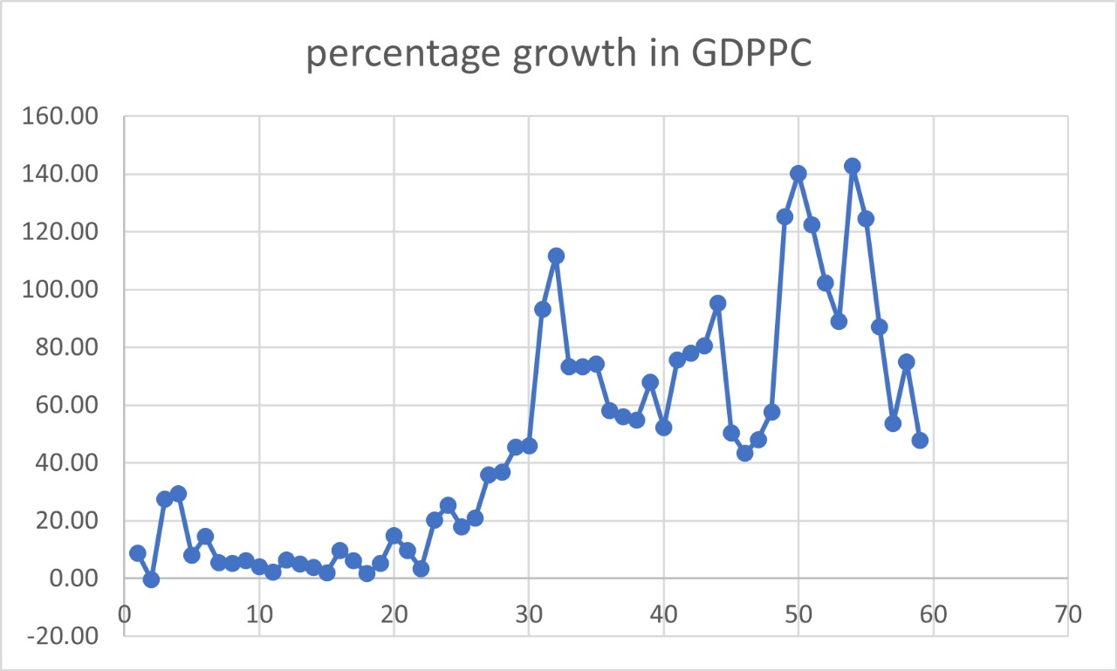
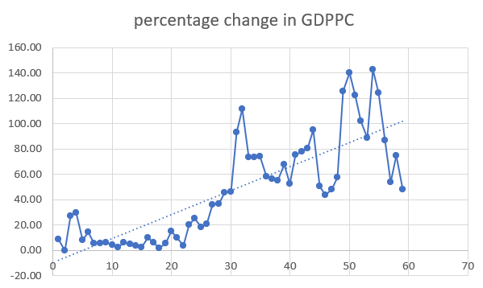
ANALYSIS OF PERCENTAGE CHANGE IN GDPPC
Countries sorted in descending order of GDPPC and thus given ranks
Formula: Percentage Change={(GDPPC in 2018−GDPPC in 2007)/GDPPC in 2007)}×100 for each rank
Graph Generation: Percentage changes plotted against ranks to visualise trends.
The trendline shows an upward slope, indicating that as the ranks go down (decrease), the percentage changes in GDPPC become more pronounced.

Slide 9
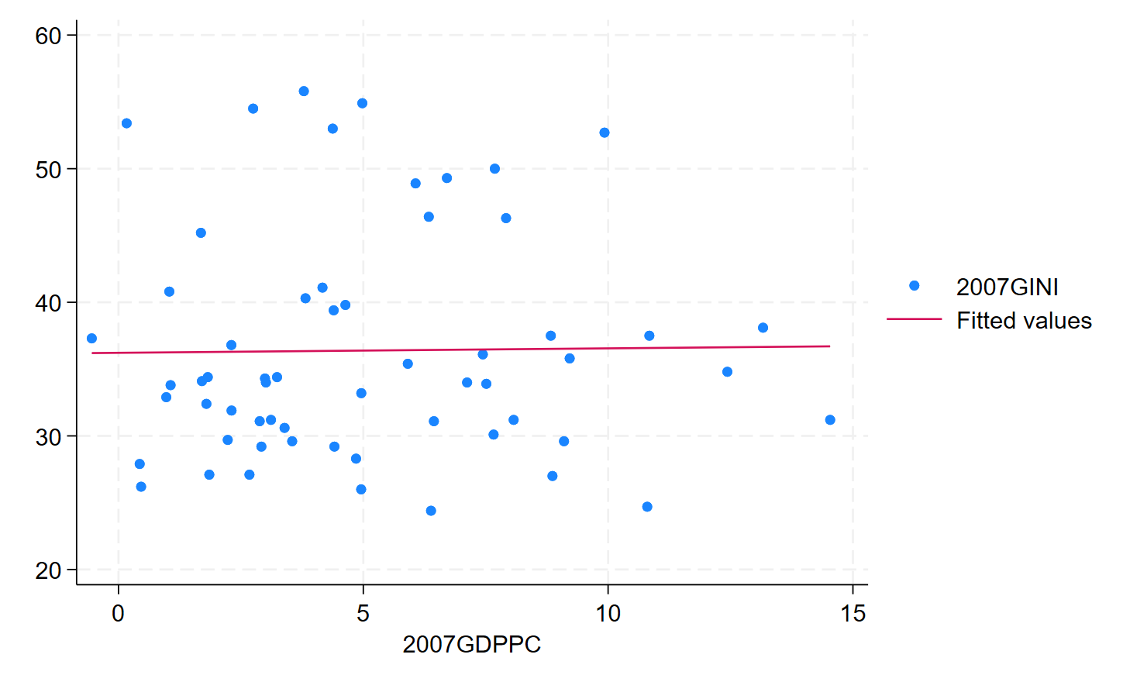
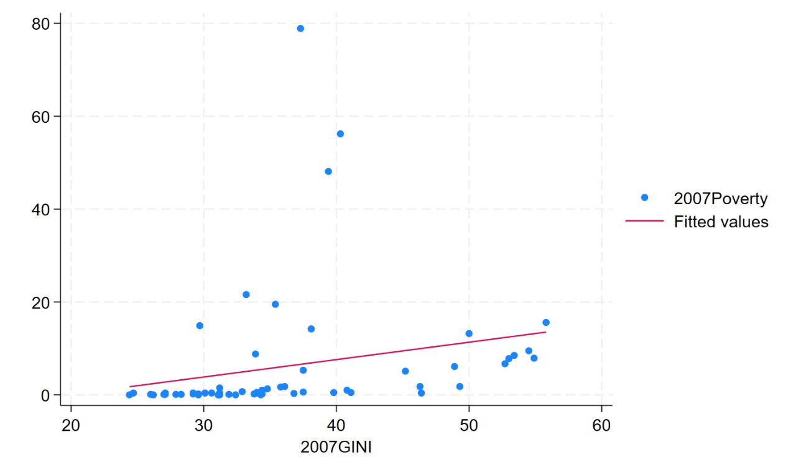
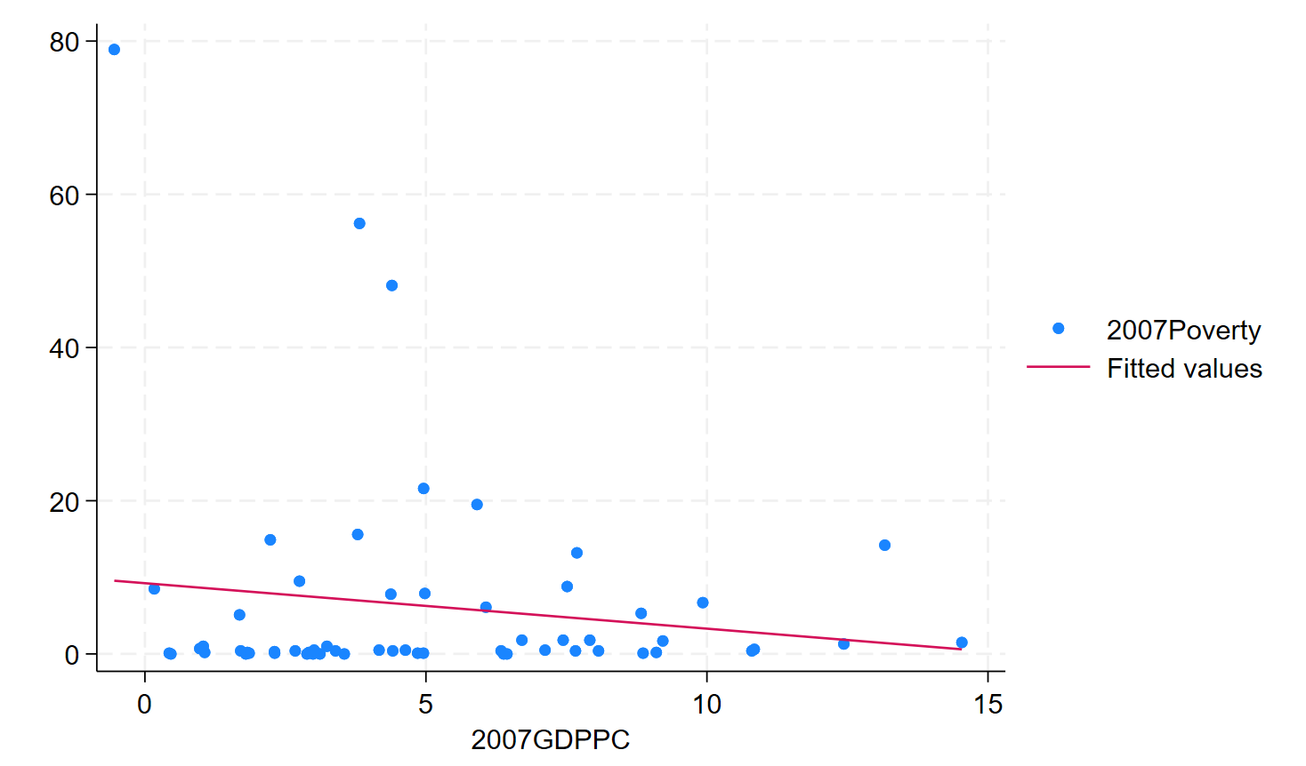
GDPPC vs INEQUALITY vs POVERTY (2007)
To map poverty, we have used the Poverty Headcount Ratio (as a % of the population).
Similarly, to map inequality, we have used the Gini Coefficient.
Ideally, there should not be any robust correlation between changes in inequality and economic development, ie. GDPPC change (denoted by GDPPC in the graphs)

Slide 10
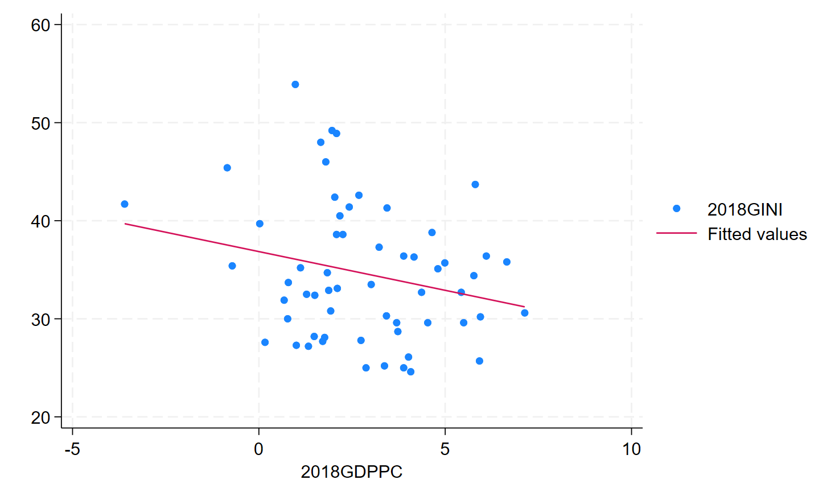
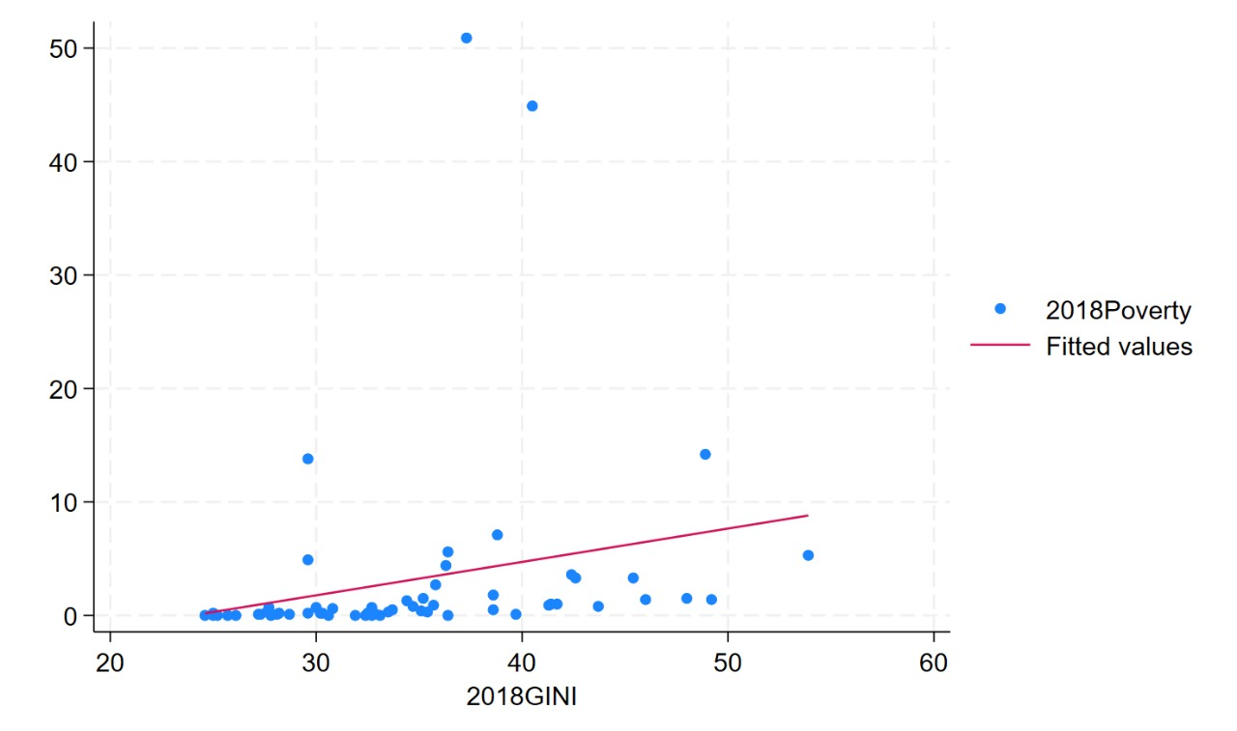
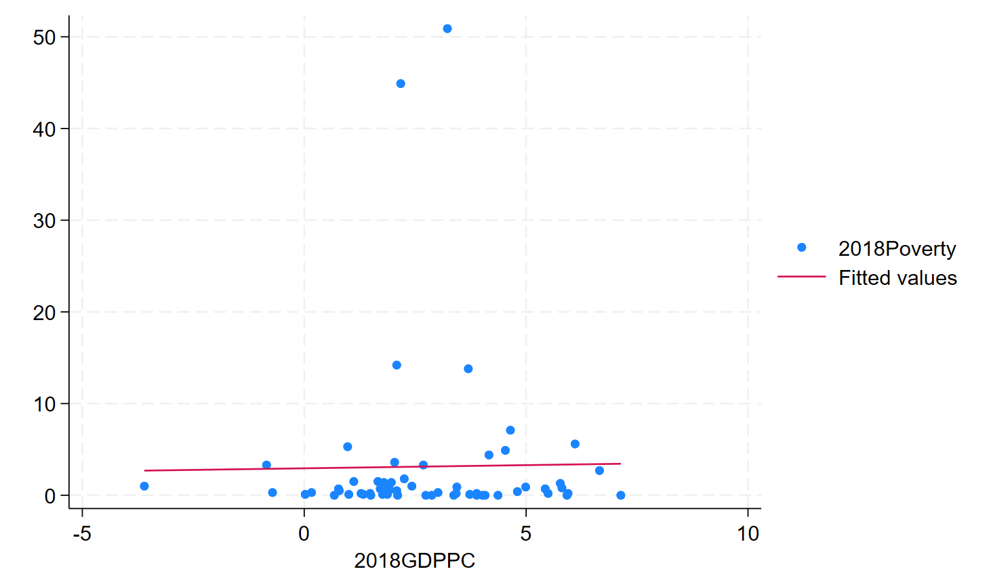
GDPPC vs INEQUALITY vs POVERTY (2018)

Slide 11
AN INTRODUCTION TO DOLLAR & KRAAY:
The Dollar and Kraay paper, "Growth is Good for the Poor", published in 2002, examines the relationship between economic growth and poverty reduction, focusing on whether growth in income leads to a proportionate improvement in the living standards of the poor.
They find that, on average, the income of the poorest 20% of the population increases in proportion to the national average income growth. This means that when a country grows, the poor tend to benefit from it as much as the overall population.
Dollar and Kraay argue that inequality in income distribution (such as rising income gaps between the rich and the poor) does not significantly affect the overall impact of growth on poverty. They observe that economic growth leads to poverty reduction even in countries with high levels of inequality.
The paper also suggests that globalization and economic integration—such as trade liberalization—can foster growth, which in turn helps reduce poverty. The benefits of such integration are particularly evident in developing countries that are open to trade and foreign investment.

Slide 12
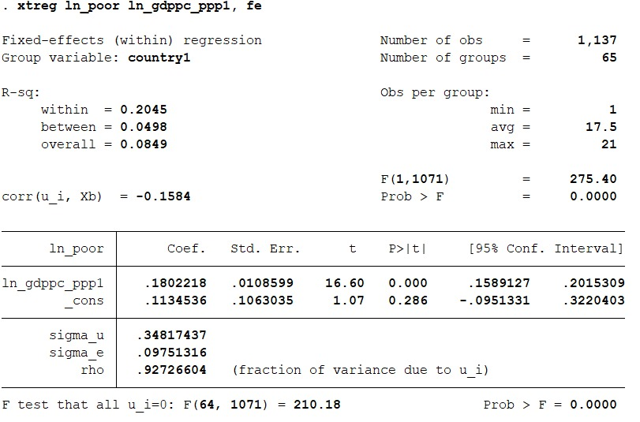
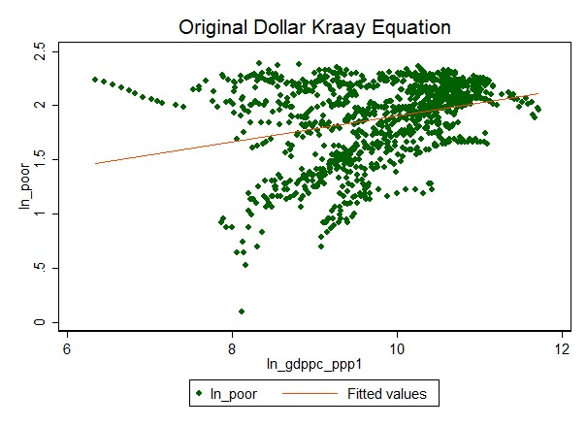
DOLLAR KRAAY REGRESSIONS ON OUR SAMPLE
We have considered log of GDPPC as the independent variable and income share held by the poorest 20% as the dependent variable.
In our sample, we found that a 1% increase in GDP per capita is associated with a 0.18% increase in the income share held by the lowest 20%, holding country-specific.
We see an upward trend which indicates that when GDPPC increases, the income held also increases; which mirrors what Dollar & Kraay had to say.

Slide 13
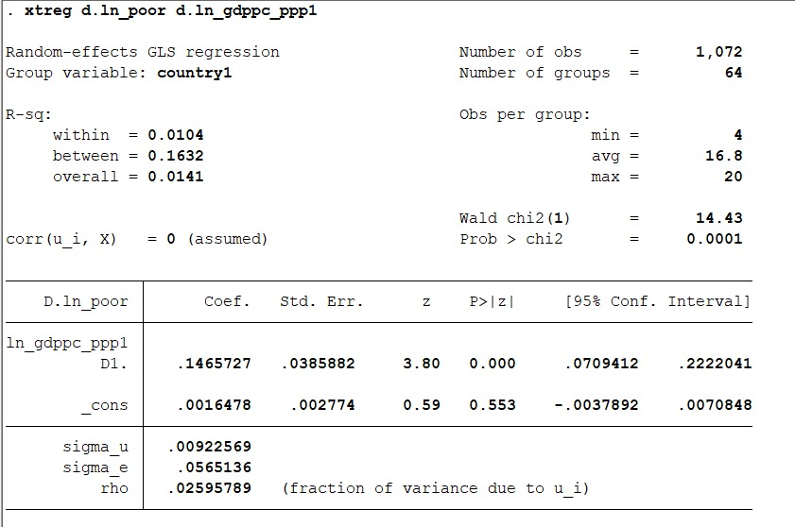
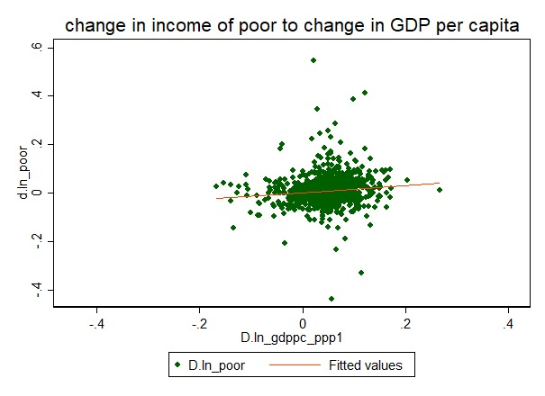
DOLLAR KRAAY REGRESSIONS ON OUR SAMPLE
We have considered d.log of GDPPC as the independent variable and income share held by the change in the income of the poor.
A 1% increase in GDP per capita is associated with a 0.1465727 unit increase in the income share of the lowest 20%.
We see an upward trend which indicates that when GDPPC increases, the income held also increases; which mirrors what Dollar & Kraay had to say.

Slide 14
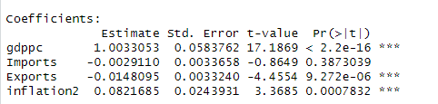
DOLLAR KRAAY REGRESSIONS ON OUR SAMPLE
When we consider income share held by the poorest 20% of the population as independent variable and log of GDP per capita (PPP), Imports, Exports and ln(1+inflation) as dependent variable, we find that:
A 1-unit increase in log of GDP per capita (PPP) is associated with an increase of 1.0031 in the income share held by the poorest 20%, holding other variables constant.
A 1-unit increase in Imports (as a share of GDP) is associated with a small decrease of 0.0030 in the income share held by the poorest 20%, holding other variables constant, although this relationship is not significant.
A 1-unit increase in Exports is associated with a decrease of 0.0150 in the income share held by the poorest 20%, holding other variables constant..
A 1-unit increase in ln(1+inflation) is associated with an increase of 0.0820 in the income share held by the poorest 20%, holding other variables constant.

Slide 15
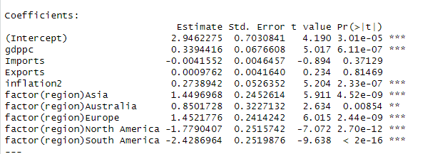
BY REGION
For Africa (reference category), the predicted income share for the poorest 20% is 2.9462, holding all other variables constant.
The income share of the poorest 20% is 1.4501 higher in Asia compared to Africa, holding other variables constant.
The income share of the poorest 20% is 0.8510 higher in Australia compared to Africa, holding other variables constant.
The income share of the poorest 20% is 1.4521 higher in Europe compared to Africa, holding other variables constant.
The income share of the poorest 20% is 1.779 lower in North America compared to Africa, holding other variables constant.
The income share of the poorest 20% is 2.4292 lower in South America compared to Africa, holding other variables constant.

Slide 16
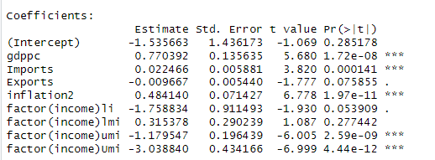
BY INCOME TYPE
For high-income economies (the baseline), the predicted income share for the poorest 20% is −1.536, holding other variables constant.
The income share of the poorest 20% in low-income economies is 1.7591 lower than that in high-income economies, holding other variables constant.
The income share of the poorest 20% in lower-middle-income economies is 0.3150 higher than that in high-income economies, holding other variables constant. This relationship is not significant.
The income share of the poorest 20% in upper-middle-income economies is 1.1791 lower than that in high-income economies, holding other variables constant.

Slide 17
POLICY IMPLICATIONS
Promoting Inclusive Growth
Structural reforms, investment in education, and infrastructure development are essential in narrowing the gap between high- and low-performing countries.
Understanding Growth Drivers
Top-performing countries highlight the importance of economic diversification, innovation, and participation in global trade networks.
Addressing Stagnation
Targeted strategies are required to resolve issues like unemployment, trade imbalances, and governance inefficiencies in stagnant economies.

Slide 18
CONCLUSION:
We analyzed economic performance using data from a set of countries over definite time periods, employing tools like mobility matrices, scatter plots, and growth incidence curves.
The mobility matrices revealed varying economic transitions, with some countries improving income positions while others stagnated or declined.
Overall, the findings emphasize the complex and uneven pathways of economic development, highlighting the need for policies tailored to reduce inequality and poverty.

